Slide 1
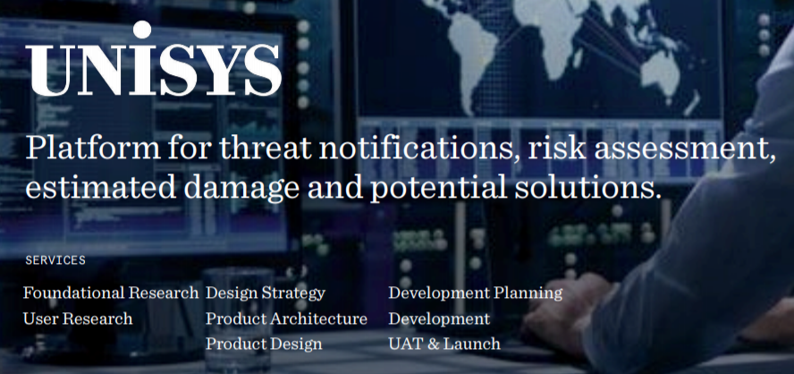
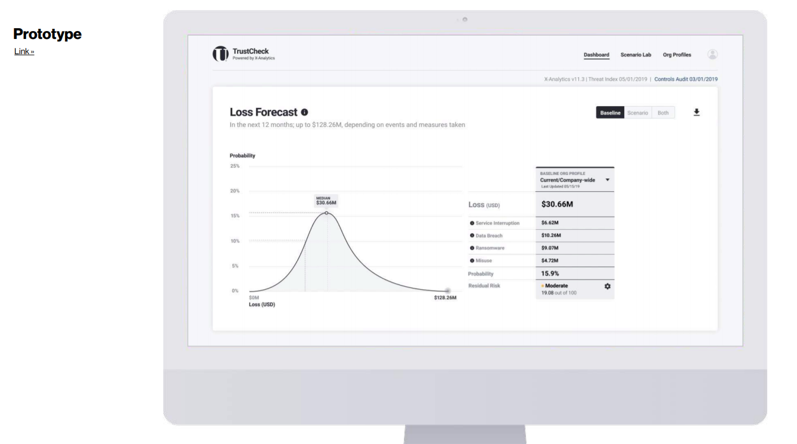
Unisys – TrustCheck
Client Need
Unisys worked with Affirma to redesign, develop and modernize a legacy product offering which was previously used via Excel. Unisys’ TrustCheck product is a tool that notifies companies about potential cyber threats, estimates the likelihood of a cyber-related financial loss and helps to propose solutions to board members. TrustCheck provides CISO and CSO’s with clear ROI through cyber insurance savings and guides investment decisions through “what-if” scenarios.
What We Did
Planning and execution of design heuristics, UX best practices and product strategy
Complete development and modernization of the product using web-based technologies - React and Azure
Advised and lead numerous product release iterations and testing cycles
Result:
Completed and deployed the updated TrustCheck product on time for Unisys to license out to their clients, spring 2020
TrustCheck won “Hottest New Cybersecurity Product” award at the RSA Conference, Feb. 2020

